Slide 1
12 principios de la animación
Diógenes Grajales Corona A01653251

Slide 2
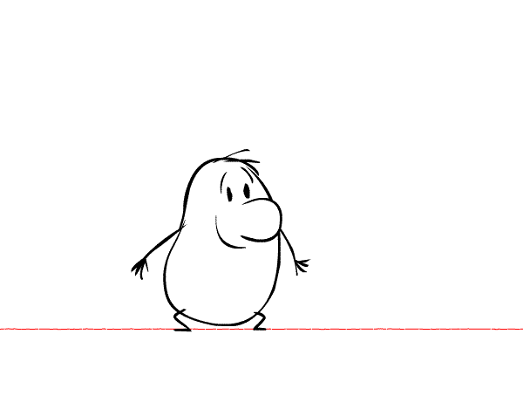
Squash and stretch

Slide 3
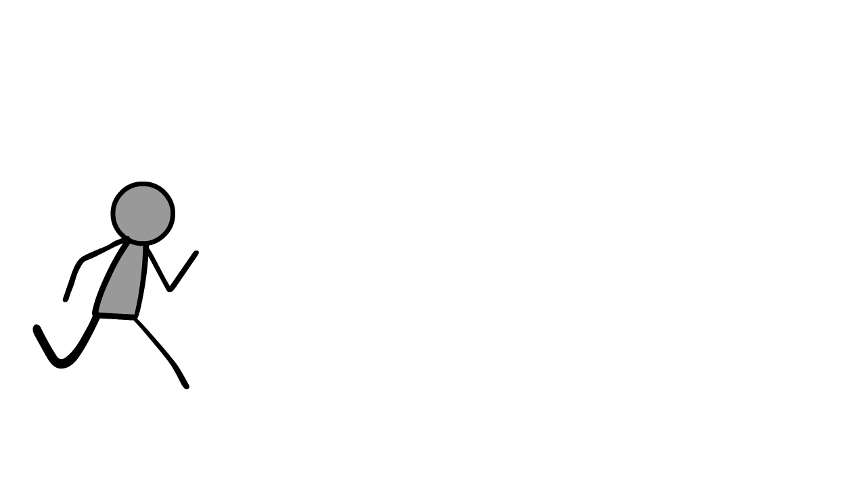
Anticipation

Slide 4
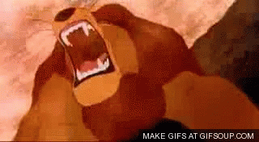
Staging

Slide 5
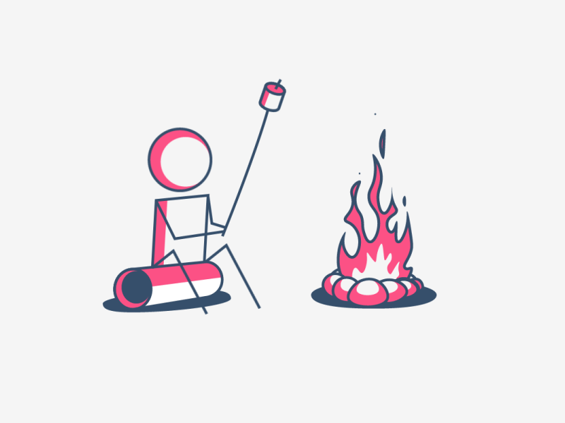
Straight ahead and pose to pose

Slide 6
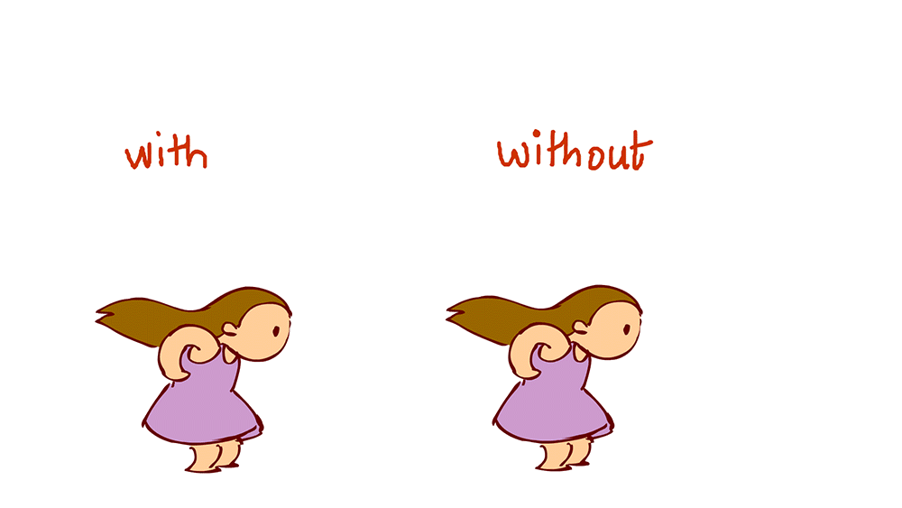
Follow through and overlapping action

Slide 7

Slow in and slow out

Slide 8
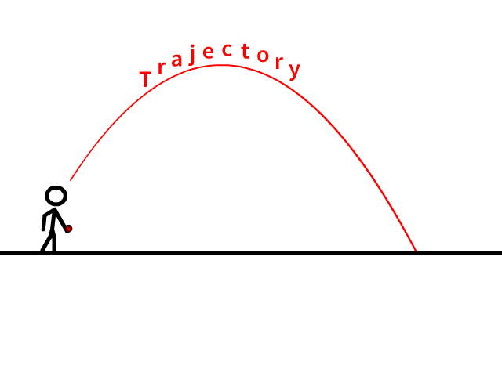
Arcs

Slide 9
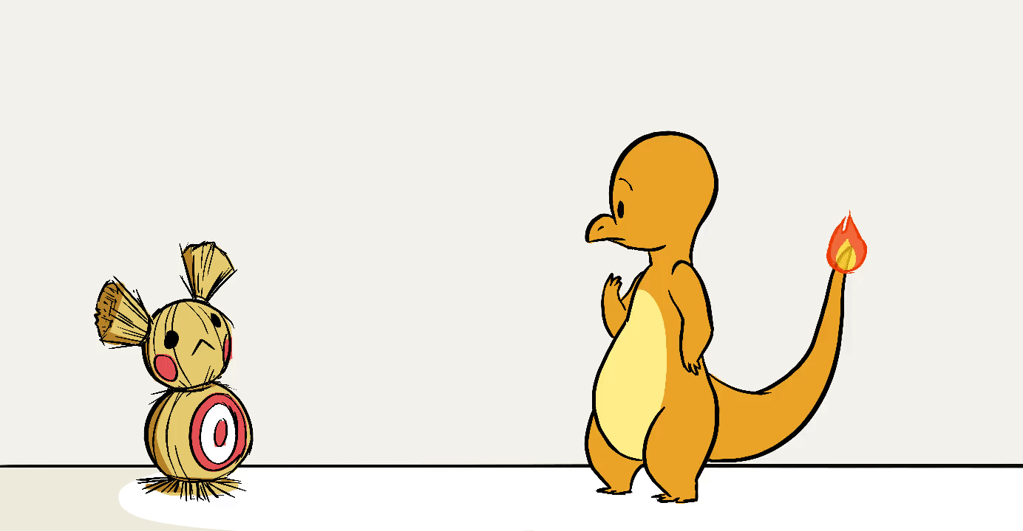
Secondary action

Slide 10
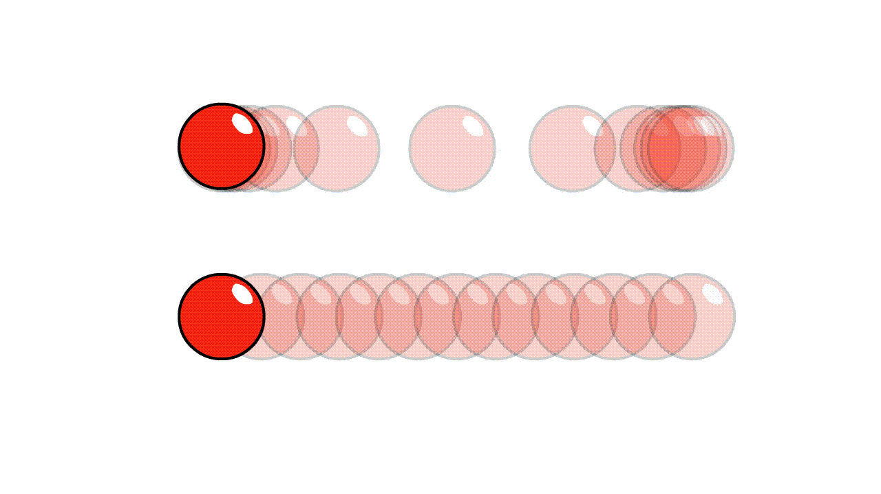
Timing

Slide 11
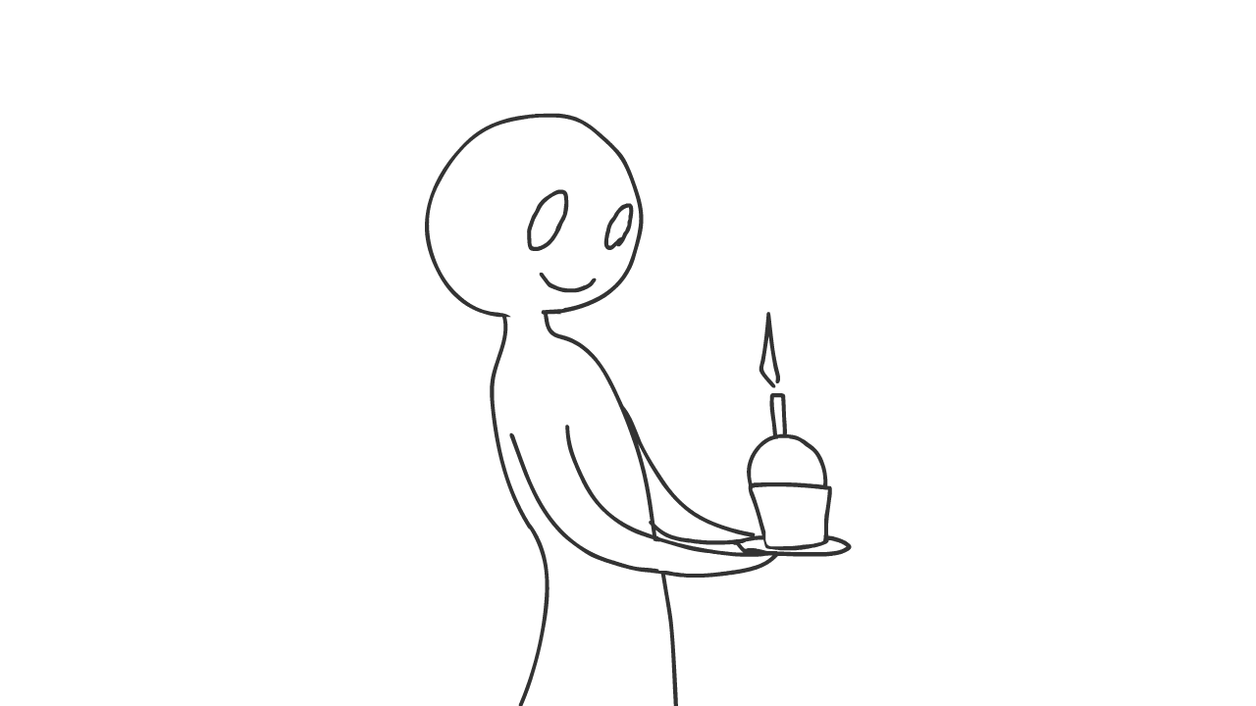
Exaggeration

Slide 12
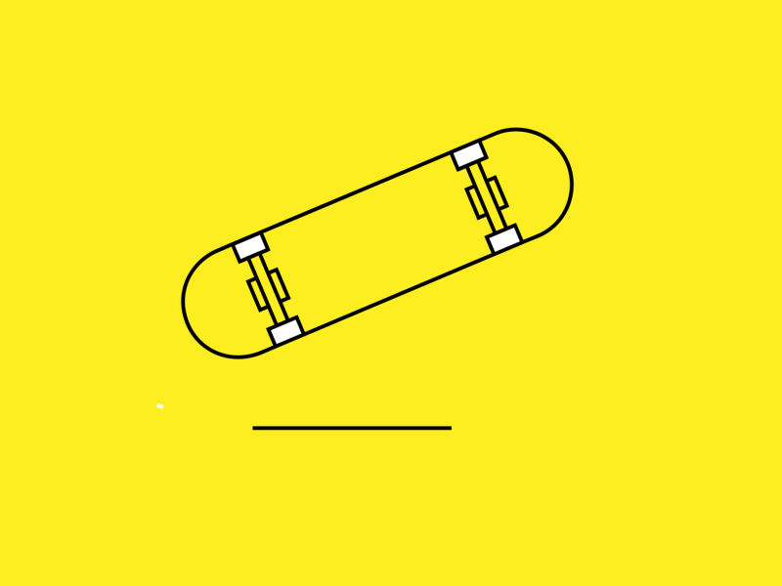
Solid drawing

Slide 13
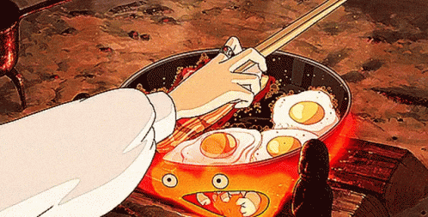
Appeal

